Slide 1
Exam Based Talk Paediatric Session
Dr Ekta Rai
MRCA, MD,FIAPA
Paediatric Anaesthesia Fellowship-Singapore KKH
Professor
CMC, Vellore

Slide 2
Overview
Paediatric Fasting Guidelines
I V fluid therapy
Fluid calculation
Securing I V lines

Slide 3
Perioperative fasting
Prescribed period of time before a procedure when patients are not allowed the oral intake of liquids or solids.
Perioperative pulmonary aspiration -Aspiration of gastric contents occurring after induction of anesthesia, during a
procedure, or in the immediate period after surgery.
Dehydrated, Hungry and Irritable Child
Happy but at risk of Aspiration
Notes:
The practice of pre-operative fasting aims to minimise residual gastric volume and acidity prior to surgery or other procedures. This helps to prevent regurgitation, inhalation and aspiration of gastric contents which may otherwise occur during general anaesthesia, regional anaesthesia or intravenous sedation. However, prolonged periods of fasting are unnecessary and may cause distress, dehydration, biochemical imbalance and hypoglycaemia, especially in children. There is also a tendency for gastric volume to increase after a prolonged fast.The purposes of these Guidelines are to (1) enhance the quality and efficiency of anesthesia care, (2) stimulate evalu-ation of clinical practices, and (3) reduce the severity of com-plications related to perioperative pulmonary aspiration of gastric contents.

Slide 4
Pharmacokinetics
Solids –Zero Order kinetics
Liquids- First order Kinetics
Factors influencing gastric emptying
Pressure gradient between stomach and duodenum
Density
Volume
Osmolality
pH of gastric fluid
Notes:
The factors influencing gastric emptying of fluids include the pressure gradient between the stomach and duodenum, and the density, volume, osmolality and pH of the gastric fluid

Slide 5
Guidelines
Clear Fluid- water, fruit juice without pulp, tea/ coffee without milk
Clear jellies without fruit, Fizzy drinks -Clear Fluid
Milk – coagulates in acid
ASA fasting for clear fluids- 2 hrs
APRICOT- Pan European trial- “Aspiration in children”
APAGBI, the French Language Society of Paediatric Anaesthesiologists and the European Society of Paediatric Anaesthetists recommends 1 hr fasting
Notes:
Clear fluids include fruit juice without pulp, water, and coffee or tea without milk; but do not include alcohol. Milk is not included under clear fluids because it coagulates in the acidic environment of stomach and delays gastric emptying.
The APRICOT study – ‘The Anesthesia Practice in Children Observational Trial’ , which is a pan European multicentric study reported that there has not been a single documented
The diurnal variation in cortisol levels effects blood glucose
levels. Cortisol levels are higher in the morning than the
afternoon, so children starved overnight have a higher blood
glucose than those starved during the day.13 The stress response
to surgery may result in hyperglycaemia in children as young
as two weeks of age, even if no dextrose-containing fluids are
given.14admission to intensive care or incidence of prolonged intubation following aspiration in children

Slide 6
Guidelines
Carbohydrate rich drink - 2 -3 hrs
Chewing gums- No restriction provided is not swallowed
Alcohol containing drinks should not be consumed within the 24 hours prior to surgery as this may increase gastric emptying time.

Slide 7
Guidelines
Breast Milk- 4 hrs
Infant Formula Feeds- 6 hrs
Solids(Light meal) and non-human milk/- 6 hrs
Fatty Meal- 8 hrs

Slide 8
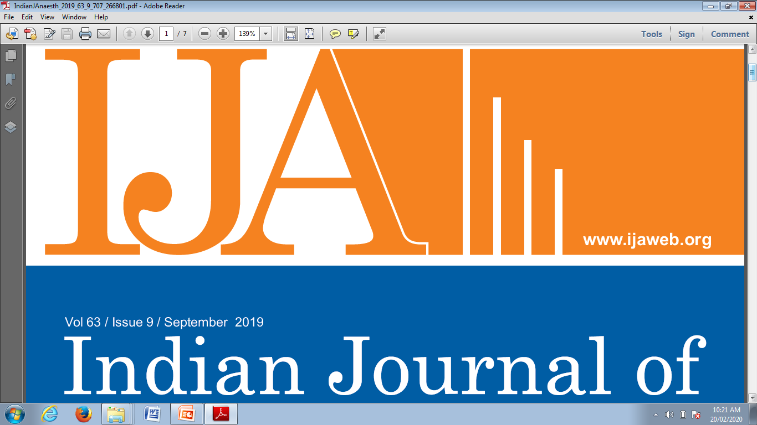
Post operative -Guidelines
The ESPEN guidelines recommend that oral intake can be initiated within hours of surgery in most of the patients.
Fluids can be started immediately if no contraindications

Slide 9
IV Fluid therapy- Children
Goal of fluid therapy?
What fluid ?
How much?
Notes:
Fluid management is an essential part of anesthetic management intraoperatively. Due to smaller size, immature organ systems and larger surface area than volume, neonate poses challenges for prescribing fluids. Correct volume and type of fluid improves the overall outcome for the neonate. Isotonic maintenance fluid results in better electrolyte balance for more than 3 days old neonates.Dextrose 1-2.5% in the maintenance fluid avoids hypoglycemia and maintains better glucose perioperatively. Hyponatremia accounts for commonest electrolyte imbalance and is responsible for majority of morbidity and mortality in children on iv fluid therapy.

Slide 10
Goal
Euvolumia
Resuscitation
Maintenance
Replacement
Normo glycemia
Electrolyte
Notes:
Fluids are given for three reasons: • Resuscitation: to correct pre-existing hypovolaemia or dehydration. • Maintenance: to provide water, electrolytes and glucose during starvation. • Replacement: of ongoing losses due to evaporation from an open wound or via the humidification of dry inspired gases, bleeding, pyrexia, gastrointestinal and third space losses (fluid leak into tissues) during surgery and into the post-operative period.

Slide 11
Physiological considerations
TBW
CVS
Renal
Hepatic
Hematological

Slide 12
Body Fluid Compartments
B
o
d
y
C
o
m
p
o
s
i
t
i
o
n
(%)
Notes:
The total body water (TBW) of a newborn is 75 – 80 %. TBW decreases gradually as fat and muscle content increase with age to the adult level of approximately 60%. The distribution of this TBW also differs for the paediatric population. The extra cellular fluid (ECF) fluid represents 45% of body weight in term neonates, 30% by the age of one year compared with 20% in adults.

Slide 13
Body Fluid Composition
Infant Child Adult
TBW 75% 70% 55%
ECF 40% 30% 20%
ICF 35% 40% 40%
Fat 16% 23% 30%
Notes:
At birth: ECF is greater than ICF
A few days after birth:
ECF contraction and wt loss due to ANP induced diuresis 2° to ↑ pulmonary blood flow & stretch of left atrial receptors
This is followed by ↑ water and Na requirements to match those of the growing infant
Implication: Fluids should be restricted until the postnatal weight loss has occurred.
Movement of fluid across a capillary is determined by Starling’s law:
Q = k A [(Pc – Pi) – ơ (πc – πi)]
Q = Net flow of fluid k = Hydraulic conductivity coefficient (Index of pore size) A = Area of the membrane concerned Pc = Capillary hydrostatic pressure Pi = Interstitial hydrostatic pressure ơ = Protein reflectance coefficient πc = Capillary oncotic pressure πi = Interstitial oncotic pressure
adults, who have about 60% of total body weight as water, about 20% of total body weight is extracellular water and 40% is intracellular water.² Newborn babies have more extracellular water—45% of total body weight—compared with only 35% of total body weight that is intracellular water.² These changes in total body fluid have important implications for drug therapy, particularly for water soluble drugs. Aminoglycosides are a classic example, as the dose varies widely by age. Premature babies require large doses, usually 5 mg/kg of gentamicin, in order to achieve adequate peak concentrations (6–10 mg/L) in the blood.⁴ The dose required to achieve the same peak decreases with older neonates, as the total body water decreases with age. By the time a patient is out of the neonatal period, the usual dose of gentamicin is 2.5 mg/kg.⁵ Drugs generally distribute into the extracellular space, thus the larger extracellular component of fluid in neonates also contributes to the need for larger doses. The interval between doses is longer in premature infants, up to 48 hours, but this is associated with the immaturity of the neonatal kidney, and not total body water.

Slide 14
Blood Volumes
Preterm 100 ml/kg
Term 90 ml/kg
Infant 80 ml/kg
School Age 75 ml/kg
Adult 70 ml/kg
Source: A Practice of Anesthesia for Infants and Children by Cote

Slide 15
Assesment of degree of dehydration
Severity of dehydration | % dehydration Infant | % dehydration Child | Symptoms
mild | 5 | 3-4 | Thirst. mucous memb moist, EJV visible in supine,CRT>2 sec, Urine sp gr>1.020
moderate | 10 | 6-8 | Dry mucous memb,↑ HR,↓ tears, sunken frontenelle, dec skin turgor, CRT 2-4 sec, ↓UO
severe | 15 | 10 | Eye sunken, cool peripheries, apathy, somnolenece, orthostatic to shocky
shock | >15 | >10 | Decompensation,poor o2 delievery, ↓BP

Slide 16
When should we give fluids?
Clinical signs
helpful but not reliable
Vitals signs
Sensitive but not specific
Electrolyte
Specific to an extent but needs sampling
Weight
The most accurate guide
Notes:
Fluid management is integral to the daily work of an anaesthetist. In managing fluid therapy in children, both volume and composition, with respect to electrolyte content, tonicity and glucose are important considerations. However, evidence base fluid management in paediatrics is limited.
Estimation of degree of preoperative dehydration is based on classical clinical signs [Table 3]. In an acute clinical situation, the weight loss of the child is usually a very good indication of total water loss. The most important sign of normal hydration status is kidney function.[3] Thus, monitoring of urinary output is essential for evaluating and treating any fluid deficit. Correction of 1% of dehydration requires about 10 ml/kg of fluids.[6]
When prescribing IV fluids, remember the 5 Rs: Resuscitation, Routine maintenance,
Replacement, Redistribution and Reassessment.

Slide 17
Remember 5 Rs-Prescription of Fluid
Resuscitation
Routine Maintenance
Replacement
Redistribution
Reassessment
Notes:
When prescribing IV fluids, remember the 5 Rs: Resuscitation, Routine maintenance,
Replacement, Redistribution and Reassessment.

Slide 18
Fluid strategies
Quantitative and Qualitative
Maintenance
Replacement
Blood and its product transfusion
Notes:
So I will try to reduce the confusion as much as possible but if its >80% then I feel its a successful presentation. To achieve 100% success , almost impossible as so many studies are going on and so many new questions are getting raised

Slide 19
Quantitative analysis
Classic fluid management
Vol of fluid = Resuscitation fluid+
maintenance fluid +
deficit +
third space loss???
Blood loss
Notes:
During surgery, fluid management aims at providing basal metabolic requirements (maintenance fluids), compensating for preoperative fasting deficit and replacing losses from surgical field.

Slide 20
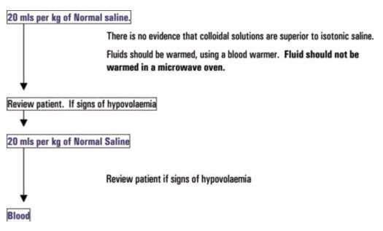
Resuscitation
Do not include this fluid volume in any subsequent calculations (PALS 2010)

Slide 21
Dehydration(Total Body loss)
Oral route , slow correction
Rapid correction should be followed with Na levels
Too rapid correction with hypotonic solutions- Cerebral edema
Notes:
Dehydration (total body water loss) should be corrected more slowly, preferably by the oral route if tolerated and time allows, but otherwise intravenously. The rapid rehydration technique advocated by Assadi and Copelovitch describes an initial rapid (1-2 hours) infusion of isotonic saline up to 60-100ml.kg-1 as required to correct hypovolaemia.3 This is followed by a slower correction of dehydration over 24-72 hours with 0.9%, 0.45% or 0.2% saline depending on measured plasma sodium. The plasma sodium should be measured at regular intervals (at least 6 hourly if outside the normal range). Too rapid correction of dehydration with hypotonic fluid will result in cerebral oedema secondary to hyponatraemia.

Slide 22
Starvation Fluid
Ideally should be nil
Prolong fasting ??
Fasting hrs X Maintenance fluid
½ - 1 hr
¼- 2 nd hr
¼ - 3rd hr
= 10 ml/kg over 1 hr

Slide 23
Maintenance Fluid-4-2-1
Holliday Segar Formula- 60% of the total amount
Oh Modification

Slide 24
Holliday Segar Formula
Historical approach to fluid management based on Holliday & Segar’s ‘4/2/1’ formula
Maintenance fluid requirements parallel energy metabolism

Slide 25
Maintenance fluids-current consensus
50% of the calculated maintenance fluid should be transfused .
New Born Term
D1 50-60 ml/kg D10
D2 100 ml/kg D10 N/2
>D7 100-150 ml/kg N/2
Older child
4-2-1 RULE
.
Recent developments in the perioperative fluid management for the paediatric patient. Paut O, Lacroix F, Curr Opin Anaesthesiol. 2006 Jun;19(3):268-77.
Notes:
necessary to reduce the volume of maintenance fluid therapy to half the previously recommended volume. The choice of an isotonic solution should be more pertinent to that of a hypotonic solution, but evidence is lacking for a definitive answer

Slide 26
Third Space Loss-Does it exist????
Sequestration of fluid to a non-functional extracellular space that is beyond osmotic equilibrium with the vascular space.
Minor Procedure- 2-4 ml/kg/h
Mod incision with Viscus Exposed- 5-10 ml/kg/hr
Large Incision with Bowel Expoed- 8-20 ml/kg
necrotising enterocolitis - 50 ml/kg/h

Slide 27
BASICS OF FLUID THERAPY

Slide 28
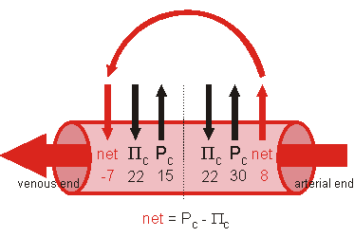
Starling forces
Osmotic Forces-Osmolality
Hydrostatic forces
Notes:
Why do the different compartments have variable fluid ?
If a semipermeable membrane separating 2 chambers obstructs the movement of solute particles but not the solute water, water will cross the membrane until the solute concentration on both sides of the membrane is equal. The force generated by this water movement is often expressed in terms of osmotic pressure (π).

Slide 29
Osmolality
Under steady state conditions, the osmolarity of all body fluid compartments is identical and equal to total body osmolarity.
Osmolality:
measure of the no. of particles (solute) present in a solution (no. of mosm/kg). Measure effective gradient of water
Serum osmolality= 2[Na]+ urea+ glucose
Normal: 285-295 mOsm/kg
Notes:
Osmotic Concentration. Particles which dissociate to form ions exert an osmotic force in proportion to the number of osmotic particles formed. For example, 1.0 mole of NaCl, if completely dissociated, forms a 2.0 osmolar solution.
Biological membranes are not impermeable to all solutes. Therefore, not all solutes can exert effective osmotic forces between the various body compartments.
Except for plasma proteins, all ions can cross the capillary endothelial cell membranes which separate the plasma water from the interstitium. Therefore, only proteins (which are in higher concentration in the plasma) exert important net osmotic forces across the capillary barrier. An increase in plasma protein concentration causes water to move from the interstitium into the plasma. A decrease in plasma protein concentration causes water to move from the plasma into the interstitium.
Membrane pumps effectively keep Na from entering cells. The osmotic force generated when there is an increase in extracellular sodium concentration causes water to move out of cells into the extracellular space. The osmotic force generated by a decrease in extracellular [Na+] causes extracellular water to move into cells.
Gibbs-Donnan Membrane Equilibrium. Proteins are not only large, osmotically active, particles, but they are also negatively charged anions. Because the proteins can not move, the distribution of other ions is influenced in an attempt to maintain electroneutrality (equal numbers of positive and negative charges) as well as osmotic equilibrium on the two sides of the membrane.
The end result of the Gibbs-Donnan effect is that more water moves into the protein containing compartment than would be predicted on the basis of the protein concentration alone.

Slide 30
Oncotic pressure
Oncotic Pressure
The component of total osmolality due to colloids
One of the Starling’s forces
Important in determining the net flow of water across the capillaries and hence intravascular volume
Albumin is the major contributor to plasma oncotic pressure
Tonicity
Concept of Osmolarity/Osmolality is simple count of the solutes which drives movement of the water
300mmolar Glucose= 300mmolar Urea= 150 mmolar NaCl
How will Cell behave if kept in all three of the above solution?

Slide 31
Tonicity
In 150mmolar NaCl- Cell will be of same volume- Isoosmolar and NaCl is impermeable through cell memebrane
In 300 mmolar Urea- Isoosmolar but Urea is permeable- cell will swell
In 300 mmolar glucose-Isoosmolar but glucose is permeable- cell swells up
Tonicity is influenced only by solutes that cannot cross the membrane, as only these exert an osmotic pressure.
Solutes able to freely cross the membrane do not affect tonicity because they will always be in equal concentrations on both sides of the membrane.

Slide 32
Control of water
Sensors
Osmoreceptors (hypothalamus: threshold is 1-2% change in serum osmolality)
volume receptors (in large veins and right atrium: stimulated by 8-10% change in volume status)
High pressure baroreceptors in carotid sinus and aortic arch
Regulator: hypothalamus
Effector
Thirst
ADH

Slide 33
Qualitative Assessment-ype of FluidT
Crystalliods
Colloids
Blood and its product

Slide 34
Type of Fluid??
Isotonic fluid –NS 0.9%, RL, Plasmalyte
Big No to hypotonic fluid-Isolyte P
Hypotonic Fluid
P stands for ??????
Day 1-3 of life – Difficult to handle Sodium load so N/2 acceptable
Intraoperative and Post operative – Isotonic fluid
Dextrose 1-2% - Maintenance Fluid
Notes:
Hyponatraemic encephalopathy in children Children given hypotonic fluid may become hyponatraemic.7,8,9,10 Ordinarily the kidneys will excrete a free water load rapidly, and homeostasis is maintained. When the body is subjected to stress such as surgery, pain, nausea or hypovolaemia, antidiuretic hormone (ADH) levels rise. ADH blocks the renal excretion of water; water is conserved, and plasma sodium levels fall. Even the relatively mild hypovolaemia of pre-operative starvation causes a rise in ADH levels.12 If the plasma sodium falls rapidly to a low level (acute hyponatraemia), water moves into the cells in compensation and causes swelling of the cells. The brain is particularly vulnerable to acute hyponatraemia; this can manifest as cerebral oedema, raised intracranial pressure, and can cause brain stem herniation, coning and death
Retrospective analyses of patients with acute hyponatraemia have shown that more than 50% of children develop symptoms when the plasma sodium is less than 125mmol.l-1, and that there is a mortality of 8.4% for severe acute hyponatraemia.
Acute hyponatraemic encephalopathy typically presents with non-specific features such as nausea, vomiting and headache; if untreated, this will progress to reduced level of consciousness, seizures, respiratory depression and death. Nausea, vomiting and drowsiness may be attributed to the side effects of anaesthesia, but unfortunately by the onset of seizures and respiratory depression it may be too late to salvage the situation

Slide 35
How to calculate Fluid transfusion?
Maintenance Fluid- 60% of the amount of Holliday Segar’s Calculation
Replacement Fluid- U/O+ NG Loss
Third space- 2-10 ml/kg
Blood Loss- Calculate MABL
Notes:
This child must be treated immediately with hypertonic saline
(3% saline) to correct the plasma sodium, not an isotonic fluid
(and definitely not a hypotonic fluid). Ideally, the child should
be cared for in a PICU and 3% saline administered as follows:6
• Give 3% NaCl 2ml.kg-1 over 10 minutes.
• Repeat as necessary 1-2 times.
• Recheck plasma Na+ after second bolus or 2 hours.
• Stop therapy when the patient is symptom free (awake,
alert, responding to commands, resolution of nausea and
headache); a rise of Na+ 5-6mmol is achieved; or there is
an acute rise in Na+ of 10mmol.l-1 in the first 5 hours.
• Do not exceed a correction of Na+ more than15-20mmol.l-1
in 48 hours.

Slide 36
MABL
MABL= EBV X Hct act- Hct des/ Hct avg
EBV= BWt X 60-100( based on age)

Slide 37
Summary
Follow ASA starvation guidelines
Hypovolemia needs quick correction but dehydration slower….
Establish entral feed as early as possible
Use isotonic fluids, HYPOTONIC fluids can be dangerous
Goal directed fluid therapy better…..
Monitor weight & electrolytes

Slide 38
Placing IV
Indication
Provide access to administer IV fluids (including dextrose and parenteral nutrition), medications,
Packed cell and blood product transfusions
Long term Antibiotics
TPN

Slide 40
DIVA Score
Score of 4 or more means >50% chance of failed initial attempt
Notes:
Score of 4 or more means >50% chance of failed initial attempt

Slide 41
Site
Hand
Dorsal arch veins
Cephalic vein, in anatomical snuffbox
Wrist
Volar aspect- small, fragile, painful
Secondary sites
Cubital Fossa- Median Antecubital, cephalic and basilic vein
Must be splinted properly
Foot
Dorsal Arch-Small, needs splinting
Saphenous Vein-Anterior to medial malleolus
Large and straight
Scalp
Superficial temporal Vein
Notes:
Dorsal arch veins –
best seen on the back of the hand
larger and easier to see and palpate over the back of the wrist.
easily splinted and any infiltration easily spotted, so these veins are the preferred site.
The feeder veins over the dorsum of the hand in the first interspace need to be treated with respect, as it is possible to cannulate an artery here, risking loss of a thumb, or part thereof. (princeps pollicis artery). This is present in about 10% of infants. If present it is usually the sole supply to thumb.
Volar aspect
Veins are easily seen on the volar side of the wrist. They are usually quite small and fragile and whilst easily cannulated, do not last well.
They are useful secondary sites, but must be carefully watched when noxious substances (eg Dopamine, Vancomycin) are infused, as they are prone to ‘burn’.
Cubital fossa
Median antecubital, cephalic and basilic veins
Median antecubital, cephalic and basilic veins are easy to hit and tend to last quite well if splinted properly. These veins are the preferred sites for insertion of percutaneous central venous catheters. These should be avoided unless absolutely necessary in any infant likely to need long term IV therapy.
The median nerve and brachial artery are both in the same anatomical vicinity and therefore vulnerable to damage.
Foot
Dorsal arch
Dorsal arch veins are small, but easily cannulated and last surprisingly well. The vein on the lateral aspect, running below malleolus, is easy to access, but must be splinted carefully and watched for infiltration.
Veins leading up to short saphenous are often good options.
Saphenous vein, ankle
The saphenous vein runs reliably just anterior to medial malleolus and is large and straight. It is easy to access and lasts well although is not always readily visualised. These veins are also good sites for insertion of percutaneous central venous catheters and should again be avoided in an infant likely to need long term IV access.
Scalp
The superficial temporal vein runs anterior to the ear and is accessible over a distance of 5-8 cm in most babies and lasts well if secured appropriately This vein is also a good site for the insertion of percutaneous central venous catheters and should be avoided if possible in infants likely to need long term IV access.
The proximity of the temporal artery, which runs beside it, is a hazard. In small infants it can be almost impossible to tell the difference, even when the catheter has been inserted. It is important to try to identify the vessels separately, by careful palpation and by observation in a good light (in the smaller infants one can see the artery pulsate). If the catheter is in an artery, it must be removed.

Slide 42
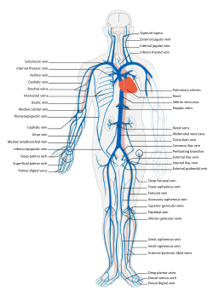
Peripheral Lines

Slide 43
Finding a suitable vein for cannulation
Warm Baby
Adequate light
Spend time in finding a straight juicy vein
Use adjunct equipment
Veinfinder-IR
USG - location

Slide 44
Preparations

Slide 45
Stabilizing the vein

Slide 46
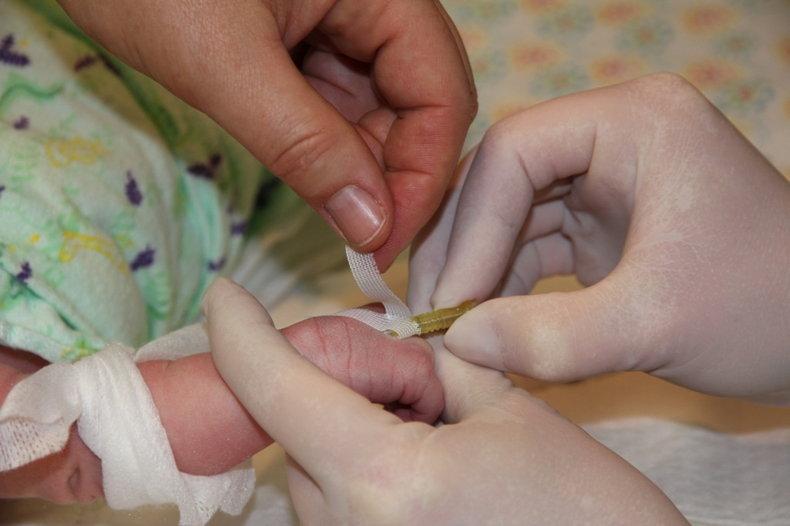
Securing cannula

Slide 47
Transillumination-Cold light
Notes:
Transillumination
Application of a COLD light directly to the skin in a darkened room can be helpful in finding veins in neonates and infants
Only cold lights (usually fibre-optic sources) should be used. Normal torches can burn the skin and should never be used
Trans-illumination adds a layer of complexity to IV insertion as the operator has to hold a light to the skin, position the site and insert the cannula

Slide 48
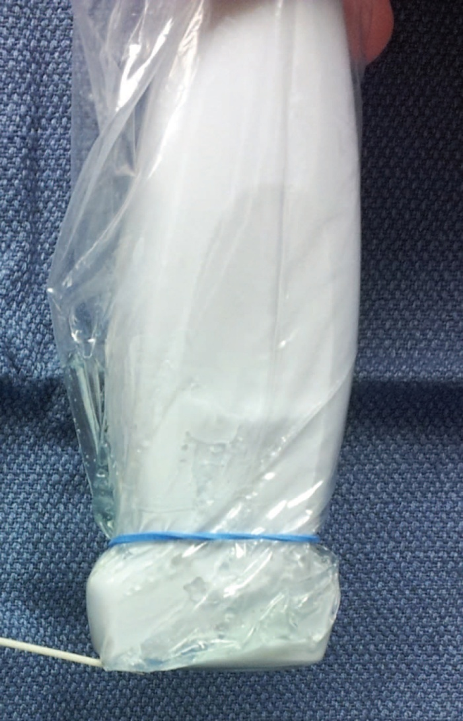
USG guided cannulation
Notes:
Ultrasound guided approach
Scan carefully for the most suitable vein
The most commonly used vein with the highest success rate in children is the cephalic vein in the proximal forearm
Other sites include the long saphenous vein at or just proximal to the ankle, or the medial aspect of the upper arm (midline catheter)

Slide 49
Tips and Tricks
Advance directly over the vein(Avoid approaching from side of vein)
Advance in stop start fashion- Flash back will be slow
Notice the change in resistance (as many a times blood may not come immediately )
Notes:
Once through skin, stop and reorient the needle tip with regards to the vein. It is much easier if one advances directly over the vein, rather than from the side.

Slide 50
Tips and Tricks
Stop when blood appears.
Check that needle is advancing along the line of the vein, correcting if necessary. Lift tip of needle slightly before advancing another 1-2mm. Check if bleeding into chamber continues
Splint- Fingers/toes must be visible, as must the area around the catheter tip
Notes:
Splint: shape the splint to the limb and immobilise the joint above the insertion site (use smallest possible and avoid pressure areas). Tape loosely at the top and over the fingers. Place another notched tape a little more firmly over the hub of the catheter, so as not to obscure the insertion site itself. If necessary, place a piece of gauze between the hub and the skin so as to avoid a pressure area. Fingers/toes must be visible, as must the area around the catheter tip

Slide 51
Securing IV- Key pointers
Site
Attempts
Aseptic precautions
Pain relief ( if not under anaesthesia)
Secure carefully
Look for phlebitis, swelling
Remove unused cannula
Notes:
Choose the site carefully, aiming to avoid an excessive number of attempts. Defer to another staff member after three unsuccessful attempts.
Use aseptic technique.
Aim to provide pain relief (oral sucrose, non-pharmacological measures).
Secure the successfully inserted cannula carefully by using a splint and appropriately placed tapes. The distal fingers or toes and insertion site must remain visible for regular inspection.
Resite promptly with signs of phlebitis, induration or swelling.
Consider elective resiting after 48-72 hours to minimise infection. Remove unused cannulas, which can act as a source of infection

Slide 52
Take Home Message
Familiarity with normal values (Vitals/ETT sizing)
Need fairly good Maths. If not, prepare all calculations before Infant is in OT
They are not mini ADULTS.
Size matters

